Slide 1
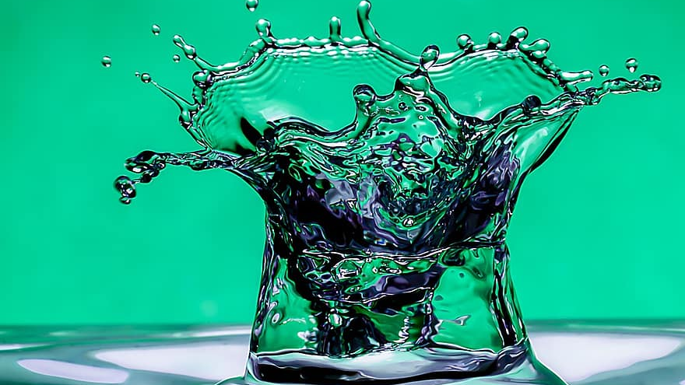
MTP Endterm Presentation
Using Deep Learning for Fluid Simulation
By Shashi (B17141) & Piyush (B17020)

Slide 2
Mid Term Report

Slide 3
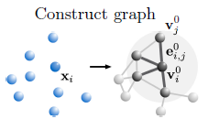
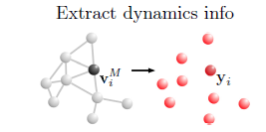
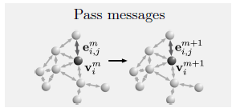
Brief Introduction
Encoder
Decoder
We are working on a Deep Learning project which can simulate fluid flow in much less time as compared to mathematical simulators. Our DL model is based on Graph Neural Network which is preferably suited to understand the complex interaction among the particles.
Processor Here processing occurs n times

Slide 4
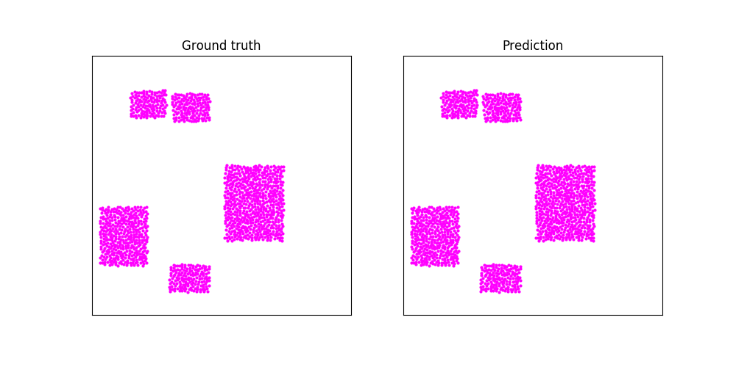
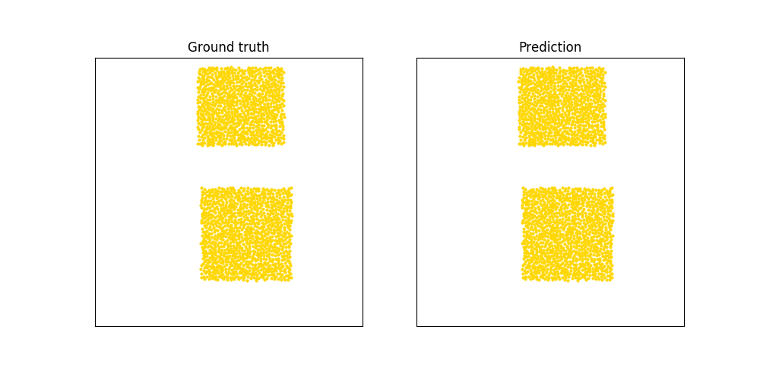
Our Previous Experiment: Generalization
We have been working in generalization of this model from last semester.
Last Sem, when trained for 2 different materials, model could not retain the learning of 1st material.
Example given here was trained on goop and then on sand dataset.

Slide 5
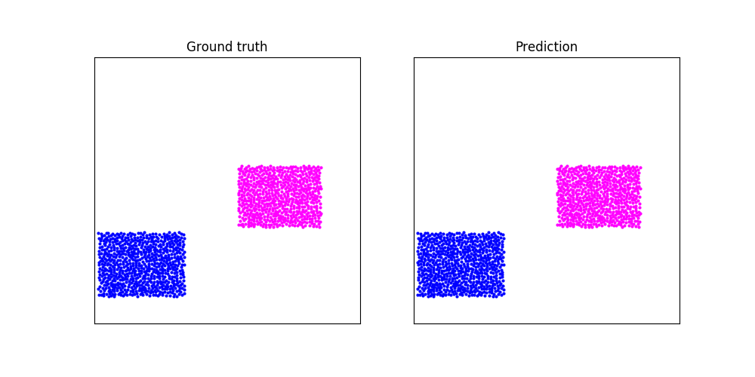
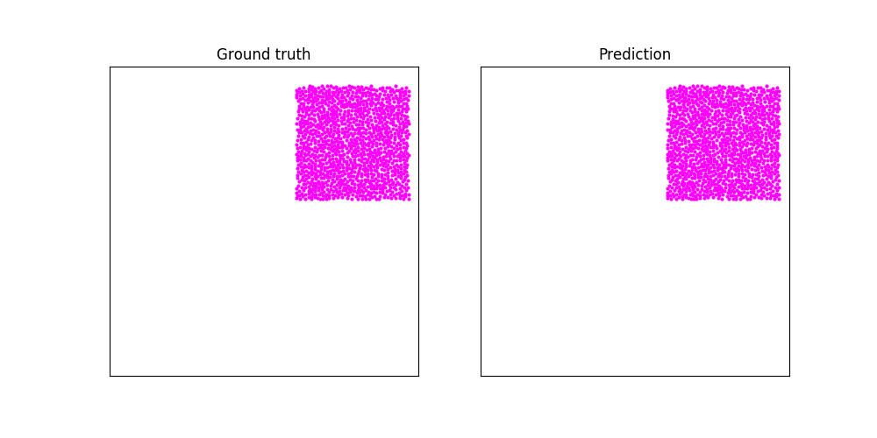
Our 1st Experiment: Generalization (One Model for ALL)
Goop-Water Example Goop Example
Notes:
We had multiple datasets for pairwise interaction. What we did was , we combined all the pairwise data along with additional single particle type data in the training set. And then trained on it. The slides contains the results that we obtained. AS we see in the First GIF we observe that the goop particles are almost intact as shown in the ground truth.

Slide 6
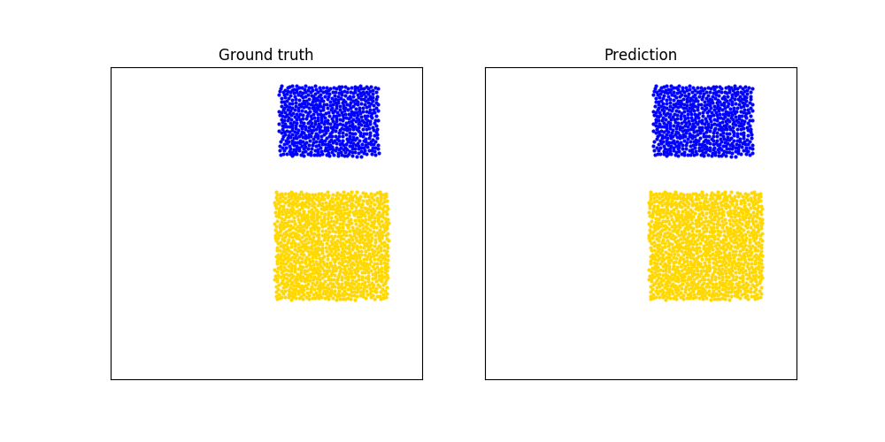
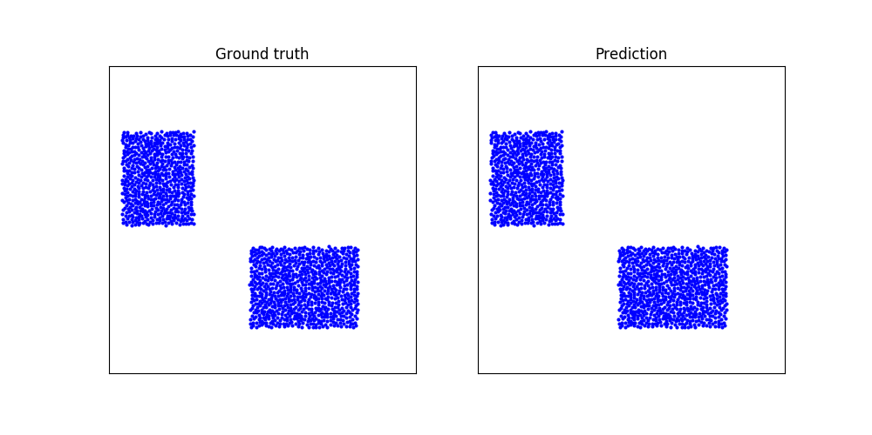
Our 1st Experiment: Generalization (One Model for ALL)
Sand-Water Example Water Example
Learnings from the experiment
The model was able to generalise.
The model was able to learn the interaction between the different types of particles.
The model was able to learn the properties of materials like density, viscosity etc.
Notes:
We see something really interesting here. Even though we used only positions of particles for training. We observe that the model learns the properties like density. As we see in the first GIF. that the water floats over sand justifying the density of particles.

Slide 7
Our 2nd Task: Generating & Preprocessing Dataset (A Challenging Task)
To move towards training our model on real world datasets, our next step was to create our own dataset.
Understanding of structure would help us in using the same model for real world data simulation as well as modifying the given dataset.
So far the data available to us was in tfrecords format. Our task was to understand how the data was encoded into tfrecords.
The paper doesn’t mention anything about data generation. So we had to do reverse engineering to figure how the data was preprocessed before converting into tfrecords.
Notes:
Our next step was to generate and preprocess the dataset to make it ready to use.

Slide 8
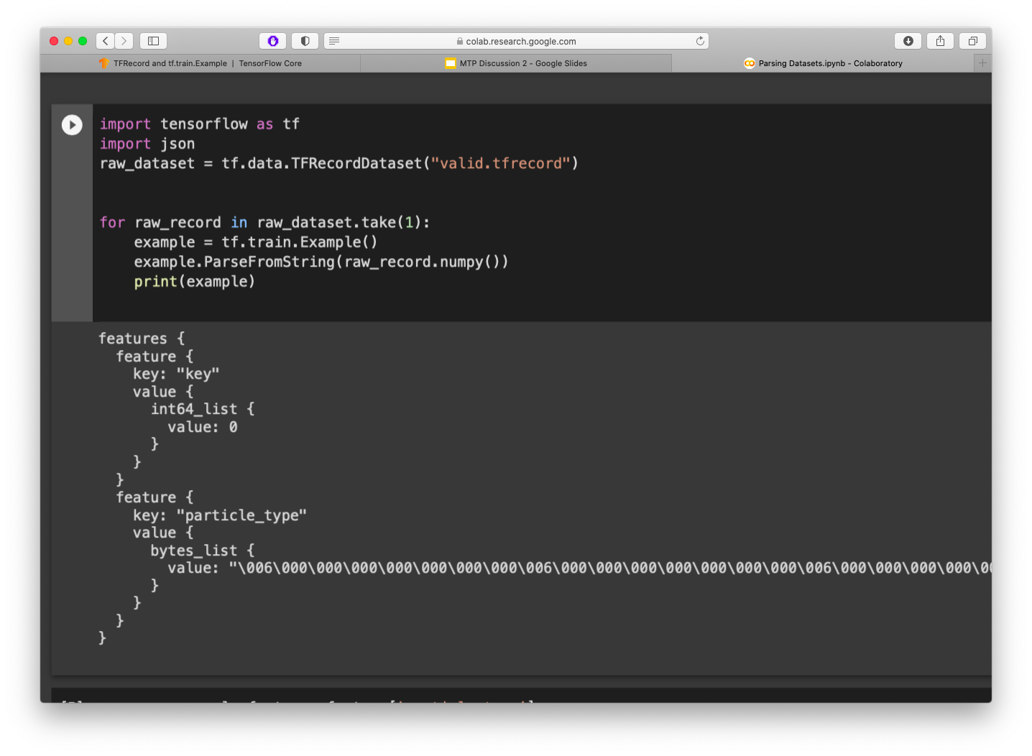
Our 2nd Task: Generating & Preprocessing Dataset
The decoding could not be done until the Feature Description of the dataset was identified.
We were able to identify the feature description from the rollout & training script.

Slide 9
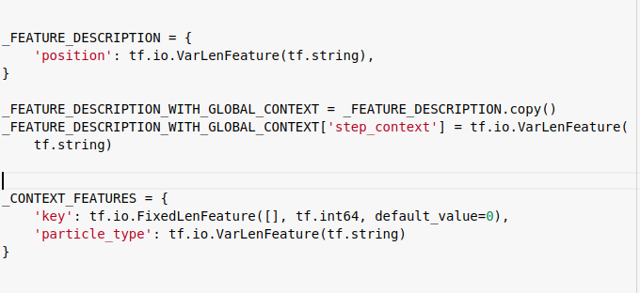
Our 2nd Task: Structure of Dataset
Once the Feature Description was identified. We are all done with preprocessing steps.

Slide 10

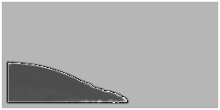
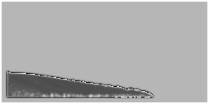
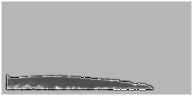
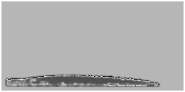
We have already setup Manta & Lighhhts softwares for generating our own dataset.
Simulation from Manta

Slide 11
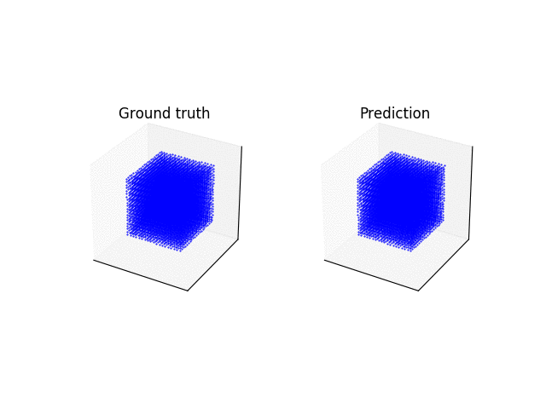
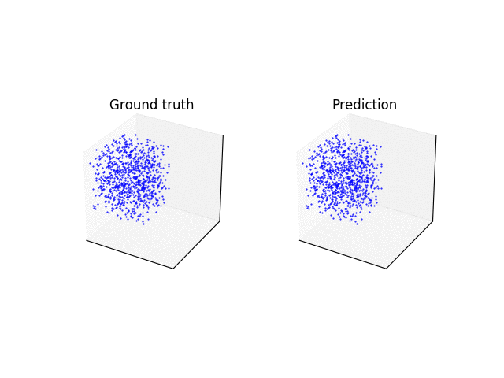
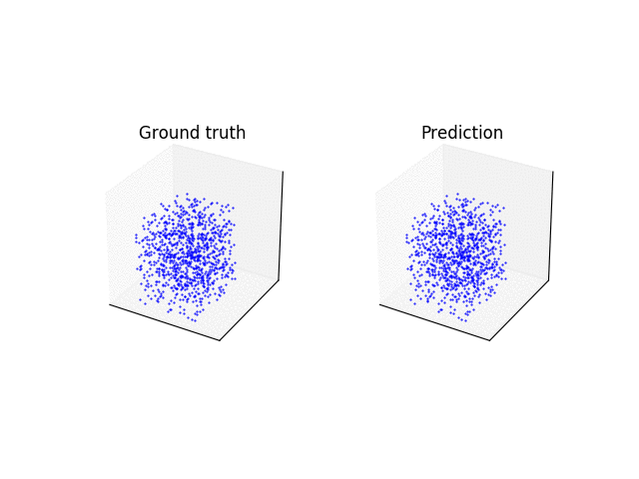
Our 3rd Experiment: Scalability (Down Scale)
No of Particles :- 7000 (approx)
Testing on 10% of actual particles (700)
We reduced the shuffling size from 512 to 32 & batch size from 2 to 1.

Slide 12
Status
Milestone 1 DONE (7th Sem)
Trained one model each for different kind of fluids.
Milestone 2 DONE (7th Sem)
Training a model to be robust to (static) obstacles.
Milestone 3 DONE
Trying to generalize the model so that one model can be used for different kind of fluids.
Milestone 4 PARTIALLY DONE
Trying to achieve scalability so that input with different number of particles can be used.
Milestone 5 YET TO START
Training the model with free objects

Slide 13
End Term Report

Slide 14
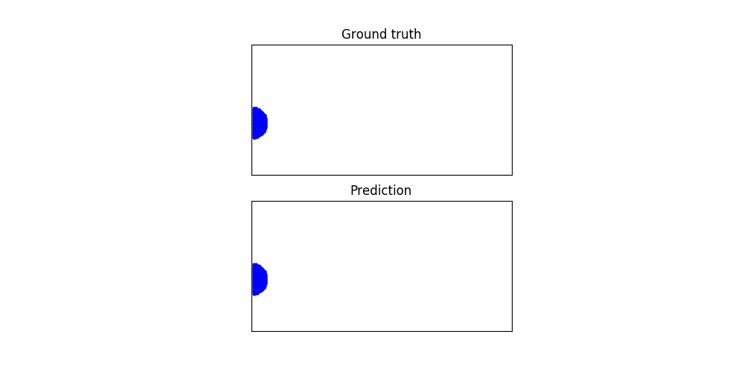
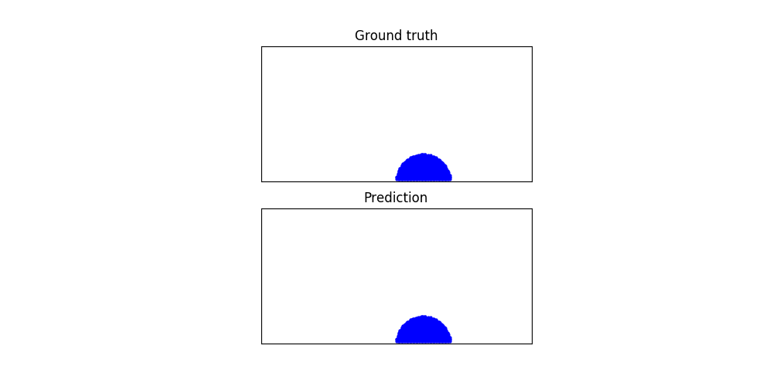
Datasets
For Creating datasets of different number of particles, we used Water Drop simulations using simulation softwares Mantaflow and LIGGGTHS.
In order to control the number of particles, we change the radius of the droplet.
Also, In order to distinguish our datasets from the given datasets we changes the aspect ratio from 1:1 to 2:1.

Slide 15
Experiment: Up-Scaling
For this experiment, we generated our own dataset using the methods mentioned in above slides. The training dataset consists of the around 500-­800 particles per sample. Each sample contains only 200 frames.
This custom data was used to train the model. Result from the model shown on the left.

Slide 16
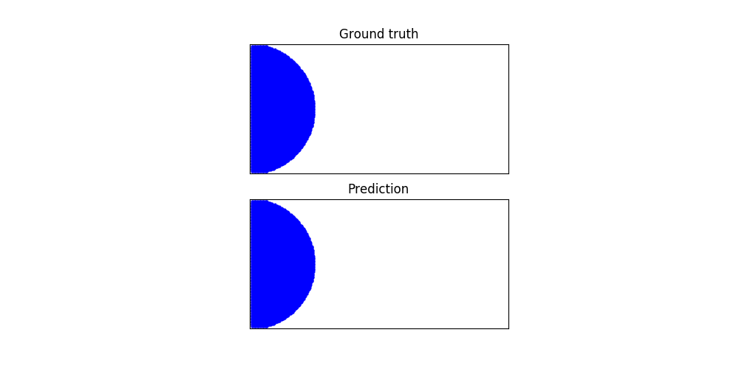
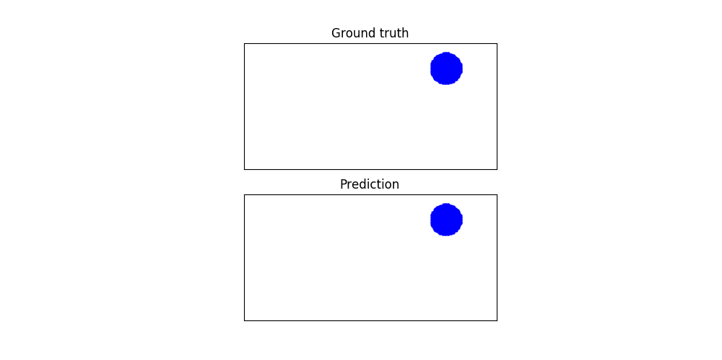
Experiment: Up-Scaling
For Testing the data, we generated multiple test datasets with different number of particles. In order to control the number of particles, we adjusted the radius as per our convenience. We used dataset with radius 0.16mm for training and radius of 0.20mm, 0.30mm 0.50mm 0.70mm for testing.

Slide 17
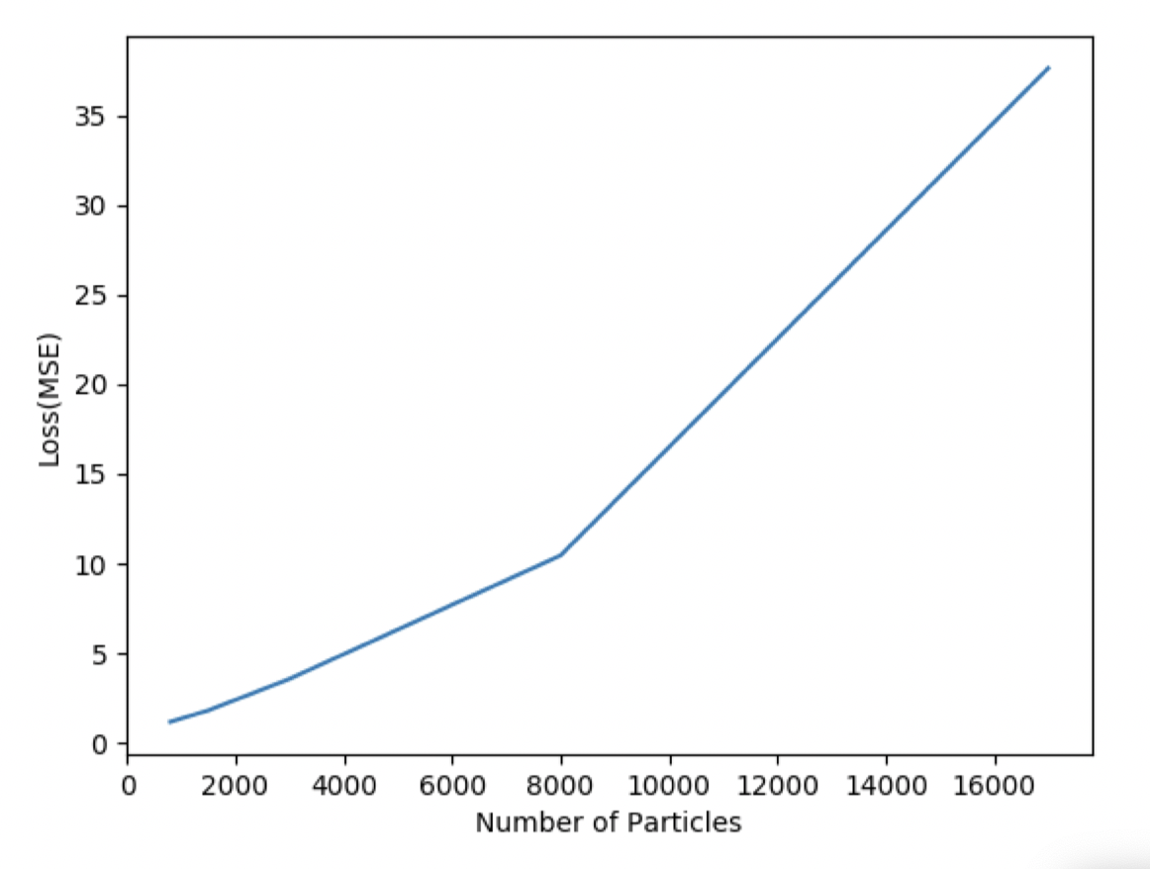
Analysis: Up-Scaling
The loss increases in exponential manner as the the number of particles are increased. This means that the model makes too much of approximation as the number of particles is increased.
Though the loss is higher in case of samples with large number of particles, the overall trajectory seems to be realistic.

Slide 18
No. of Particles vs Time taken
We observed that the average prediction generation time is always less than the average ground truth generation. This means that the Deep Learning model is able to generate faster results as compared to simulating softwares.
The shown table is for 200 Frames and 2D data. That’s why prediction are in sec.
Approx. Number of Particles | Avg. Ground Truth Generation Time | Prediction Generation Time
800 | 10 secs | 5.4 secs
1.5k | 15 secs | 7.1 secs
3000 | 22 secs | 10 secs
8000 | 140 secs | 45 secs
17000 | 310 secs | 65 secs

Slide 19
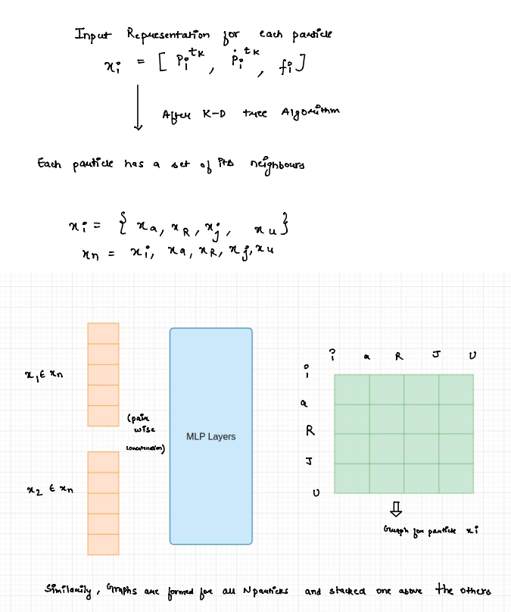
How does it work ?

Slide 20
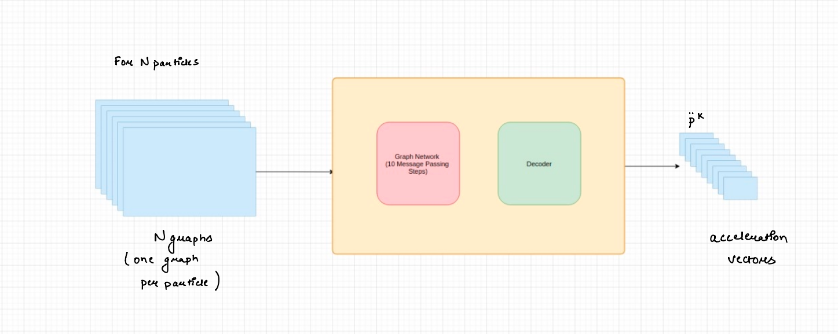

Slide 21
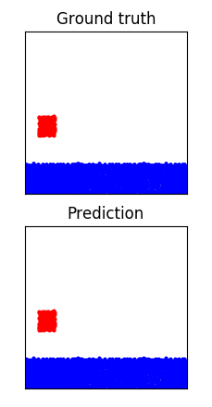
Experiment : Free Objects
In this experiment, we used free objects like a solid box. The dataset contains samples where the container with water and the box was shaken side to side.
The model was able to predict the motion of the rigid block accurately. Though the particles of the rigid block remain intact with each other, the shape of the block is deformed.

Slide 22
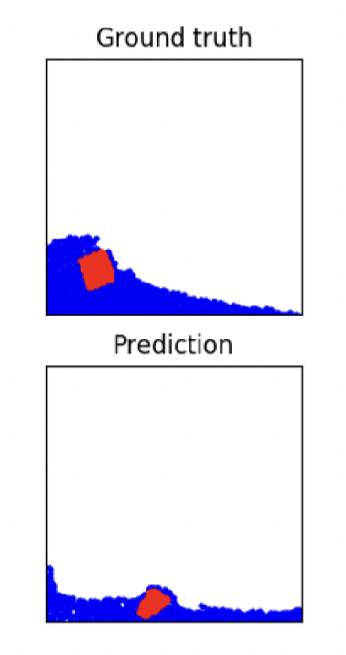
Failure Cases
In case of FluidShake­Box Dataset, we observed that though the model was able to predict the motion of the rigid box but the shape of the box was deformed towards the end of the trajectory.
In case of Goop Dataset. We observe that for some predictions, the blobs of goop material stick to the wall of the container..

Slide 23
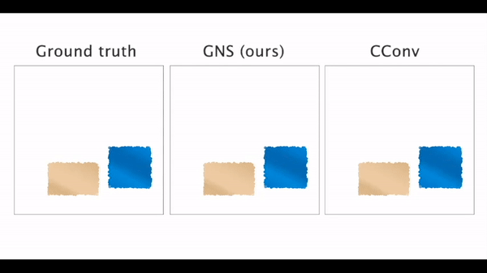
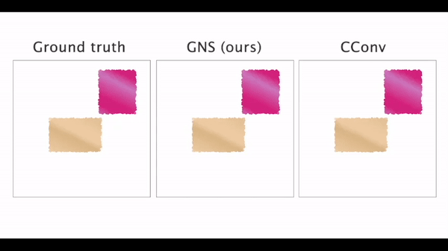
Comparison to Other DL Models
We implemented the CConv model, testing procedure as described in the papar “Lagrangian Fluid Simulation with Continuous Convolutions”.
We obtained the pre-trained weights for Cconv using the source : https://github.com/intel-isl/DeepLagrangianFluids/blob/master/scripts/pretrained_model_weights.h5

Slide 24
Overall Conclusion
Takes Lesser time to generate simulations
Approx. Number of Particles | Avg. Ground Truth Generation Time | Prediction Generation Time
800 | 10 secs | 5.4 secs
1.5k | 15 secs | 7.1 secs
3000 | 22 secs | 10 secs
8000 | 140 secs | 45 secs
17000 | 310 secs | 65 secs

Slide 25
Overall Conclusion
Capable of learning Material Properties
Goop-Water Example Water-Sand Example

Slide 26
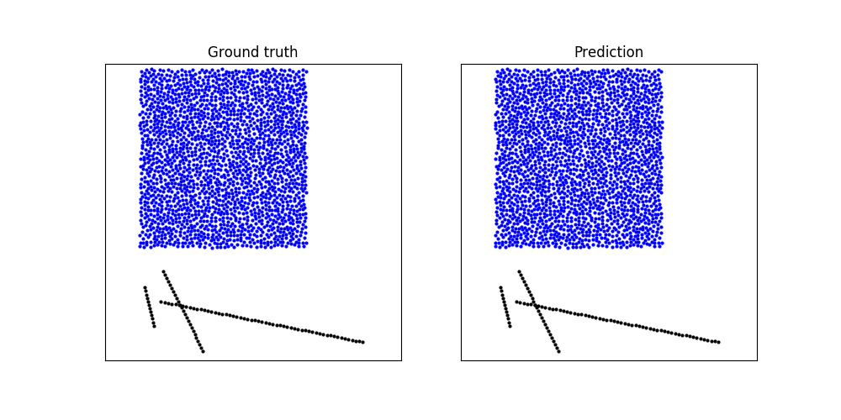
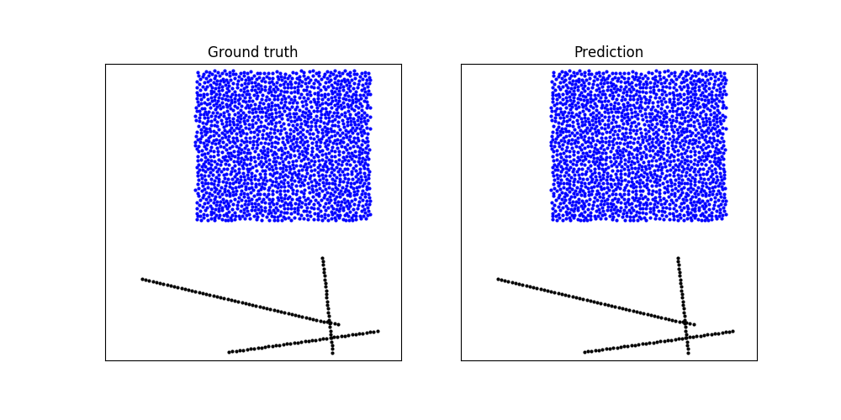
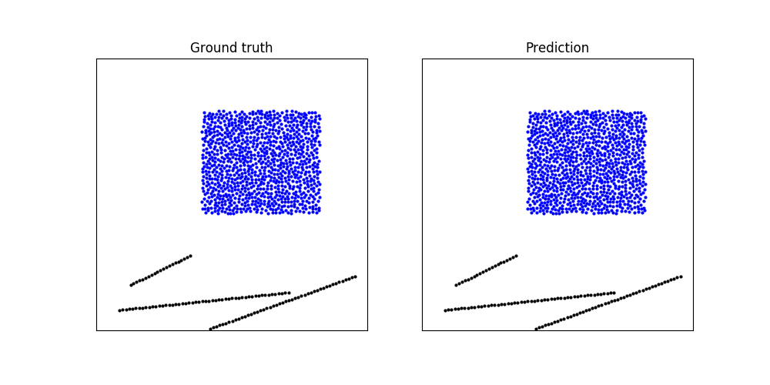
Overall Conclusion
Robust to Obstacles

Slide 27
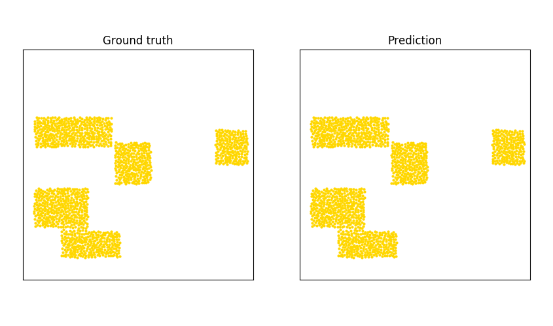
Overall Conclusion
Generic to Particle Type (one model for all)
Goop Example Water Example Sand Example

Slide 28
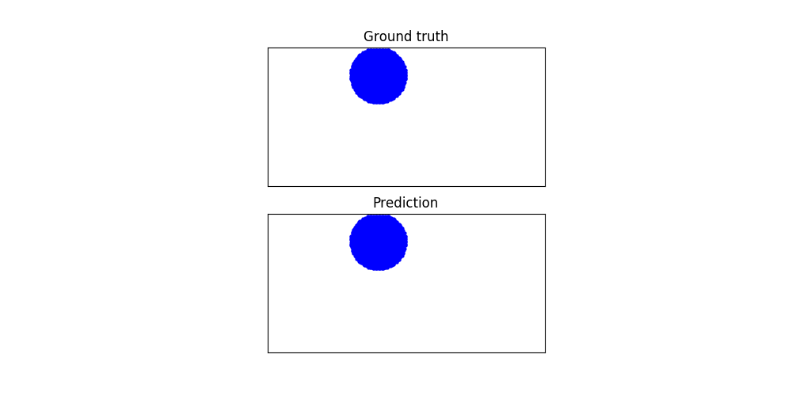
Overall Conclusion
Independent of the number of particles

Slide 29
Acknowledgement
We would like to sincerely thank Dr. Gaurav Bhutani for his guidance during the entire duration to make this project a great success. His inputs in this project have played major role in obtaining noval results.
We would also like to thank Dr. Kunal Ghosh and Dr.Aditya Nigam for carrying out the MTP processes in a very convenient manner and giving us their valuable feedback on our work to help us improve.
We would also like to thank Mr. Hrishikesh Sagar for providing us with his previous work material and a helping hand in this entire project.

Slide 30
References
Wikipedia contributors.Magnetohydrodynamic. [Online;accessed Feb. 14, 2021]. 2021.
Miles Cranmer et al. “Discovering symbolic models from deep learning with inductive bi­ases”. In:arXiv preprint arXiv:2006.11287(2020).
FluidFlow FlowAnalysisSoftware.https://www.autodesk.com/solutions/simulation/cfd-fluid-flow. [Online; accessed Feb. 14, 2021]. 2021.
Sandia National Laboratories.LIGGGTHS Simulator.https://www.cfdem.com/.[Online;accessed 22­May­2021]. 2021.
LIGGGHTS OPEN SOURCE DEM PARTICLE SIMULATION CODE.https : / / www .cfdem . com / liggghts - open - source - discrete - element - method - particle -simulation-code. [Online; accessed April. 18, 2021]. 2021
H. Sagar. “”Neural Network in snow avalanche dynamics””. In: Indian Institute of Technol­ogy Mandi. 2020.
Kiwon Um, Xiangyu Hu, and Nils Thuerey. “Liquid splash modeling with neural networks”.In:Computer Graphics Forum. Vol. 37. 8. Wiley Online Library. 2018, pp. 171–182.
BenjaminUmmenhoferetal.“LagrangianFluidSimulationwithContinuousConvolutions”.In:International Conference on Learning Representations. 2020

Slide 31

Thank You
Both Piyush & Shashi have contributed equally.

Slide 32
Appendix Slides-
Understand the basics of GNS Model used here!

Slide 33
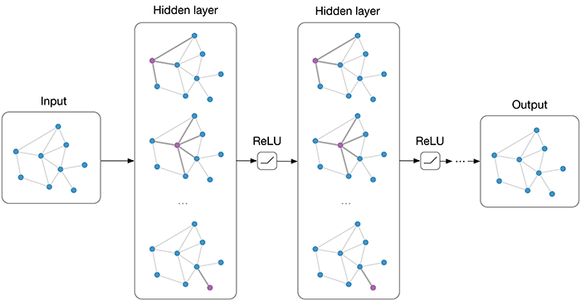
Our Approach: Graph Neural Network
We do know that interaction between fluid particles are quite complex. And graph network, an abstract data types is suited best to understand such complexity.
Encoder and Decoder are used to reduce amount of processing & thus, reduces time consumed.

Slide 34
Aha! Graph Neural based Simulator(GNS) Model
Encoder
Decoder
The ENCODER constructs the graph structure G by assigning a node to each particle and adding edges between particles within a “connectivity radius”, R, (where R is a hyperparameter) which reflected local interactions of particles, and which was kept constant for all simulations of the same resolution.
The PROCESSOR uses a stack of M MLP’s (where M is a hyperparameter) with identical structure, computing updated internal edge and node.
The DECODER, after computing the future edges (PROCESSOR), extracts dynamic information of each particle, outputs yⱼ corresponding to accelerations, Їⱼ (I is position vector), using an Euler integrator with 2D or 3D dimension, depending on the physical domain.
Processor Here processing occurs n times

Slide 35
TRAINING DATA
Two Files : train.tfrecord and metadata.json
Metadata.json contains : information about boundaries, sequence length, connectivity radius, dimension(2D,3D), time interval (dt).
train.tfrecord : Contains samples with only information about the positions of the particles.

Slide 36
GNS Architecture
PREPROCESS
ENCODER
PROCESSOR
DECODER
State is processed in this sequence and final output from decoder is updated to the previous state.

Slide 37
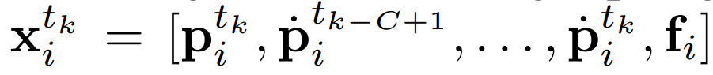
FLOW CHART
Input representation:
PREPROCESS
Where k = Kth timestep, P = Position of particle X_{i} , C = hyperparameter and f_{i} = material properties. f_{i} is a vector of size 16 with encoding of properties like (water, Goop, Sand, Boundary, gravity etc).
The velocity at Kth step at time t, is taken as the average of the current and C-1 previous velocities.
We use K-D tree algorithm to find the neighbours of the particle X_{i} within the range of radius R and at most L particles.

Slide 38
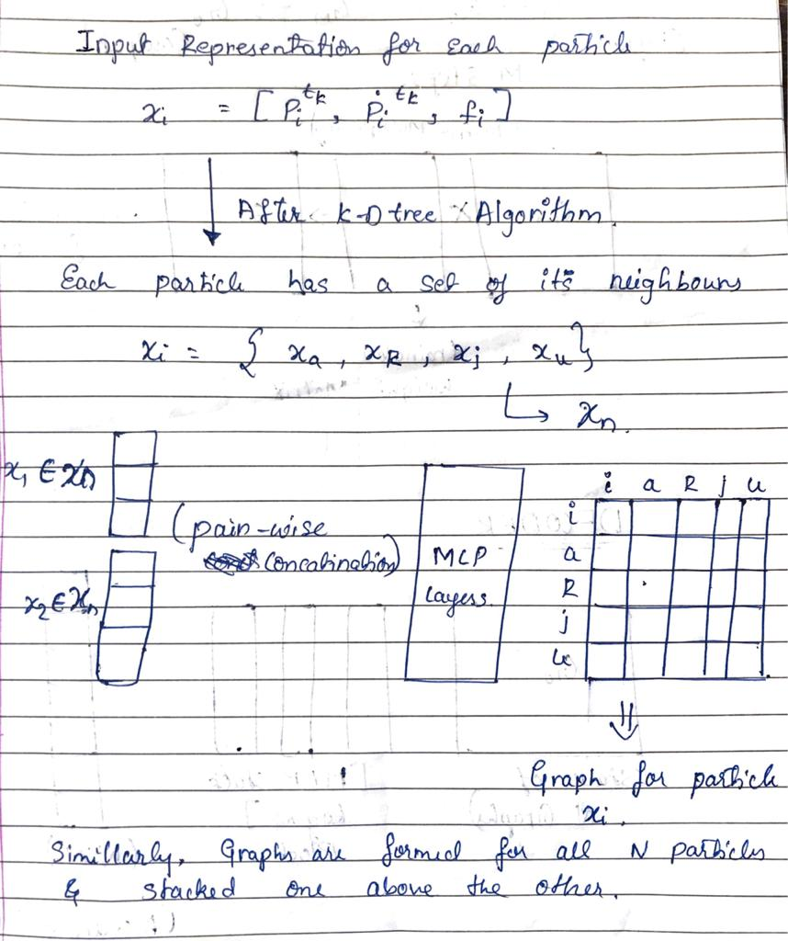
FLOW CHART
ENCODER
If # particles = 500.
Original size = 500 X 500.
Now, (for 9 neighbours)
Size of graph for one particle = 10X10
Total size of all graph = 500 X 10 X10
Reducing the size by 80%

Slide 39
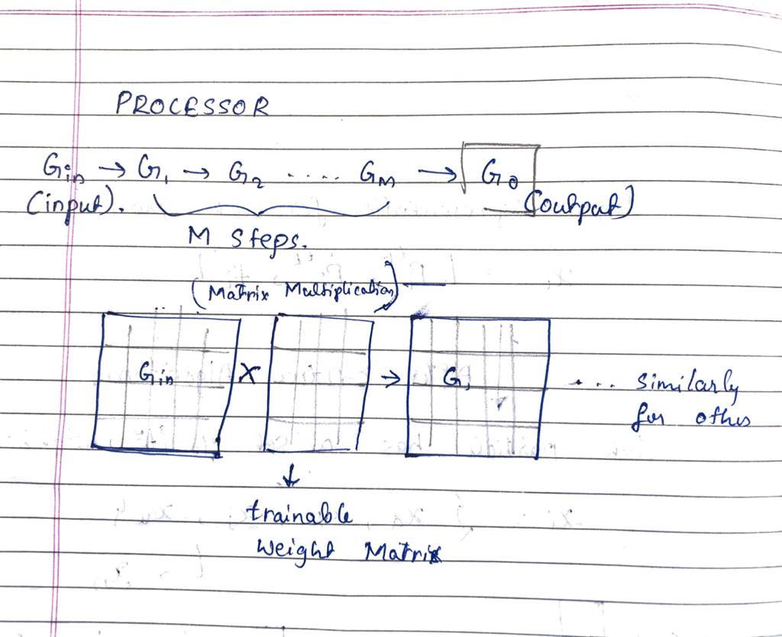
FLOW CHART
PROCESSOR

Slide 40
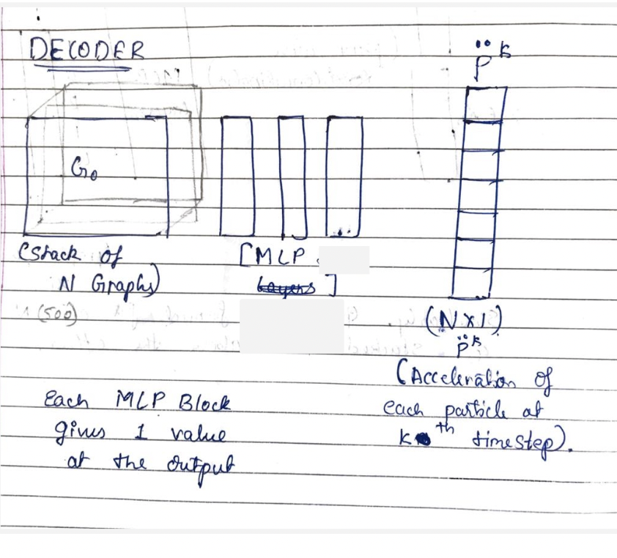
FLOW CHART
DECODER

Slide 41
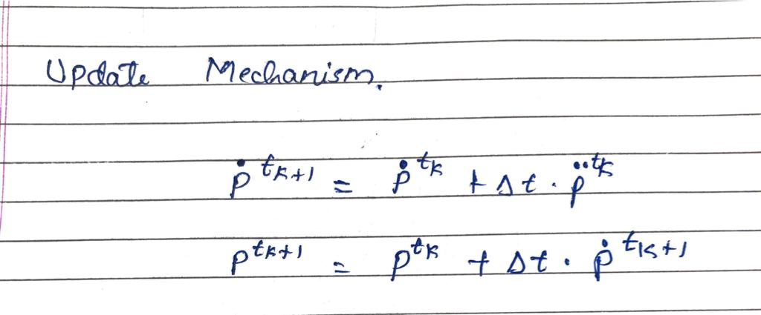
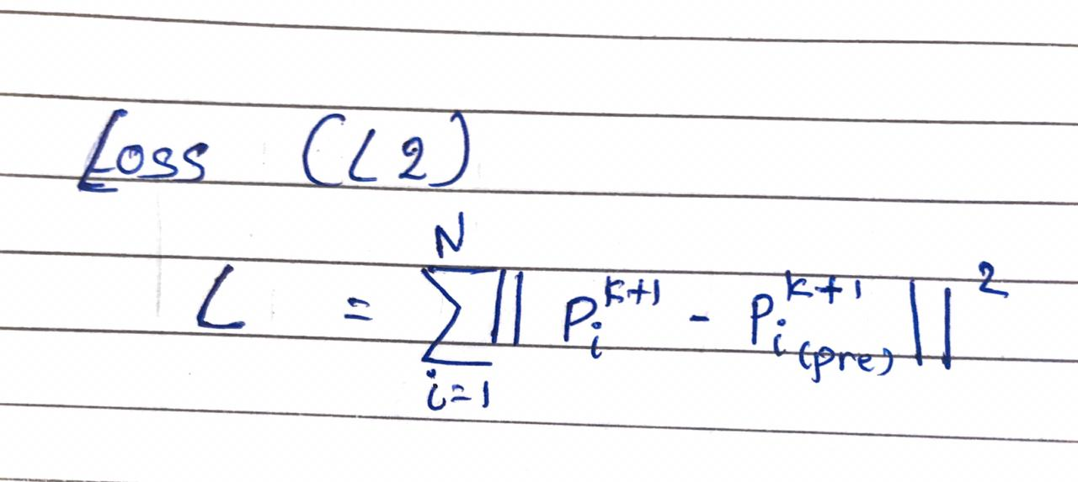
Update Mechanism & Loss

